Slide 1
Aesthetic Qualities
Miss Khoury

Slide 2
The Ingredients for Writing about Aesthetic Qualities
First we have the ART ELEMENTS:
Line, colour, shape, form, tone, texture and space
How we arrange them creates the ART PRINCIPLES:
Unity, contrast, movement, balance, variety, harmony, emphasis (focal point)
How we use the art elements and art principles creates the AESTHETIC QUALITIES
Happy, mournful, scary, dramatic, sombre….

Slide 3
AESTHETIC QUALITIES
Aesthetic qualities are defined in the study guide as “The way in which art elements and principles, materials and techniques work together to influence the mood, feeling or meaning of an artwork.
In Studio Arts you are usually asked about how the art element and principles create aesthetic qualities (ie- generally you can ignore the bit about materials and techniques)
Aesthetic qualities could be: gentle, angry, dramatic, calm, happy, soft, hard, rough, bright, sharp, harsh, dark, heavy, peaceful … etc

Slide 4
List of MOODS/ FEELINGS of an artwork
Calm, content, peaceful, relaxed, tranquil
Cheerful, happy, joyful, romantic
Depressed, gloomy, miserable, sad, somber, tearful, unhappy
Aggressive, angry, chilling, dark, distressing, frightening, violent
Energetic, exciting, stimulating, thought-provoking
Boring, dull, lifeless, insipid

Slide 5
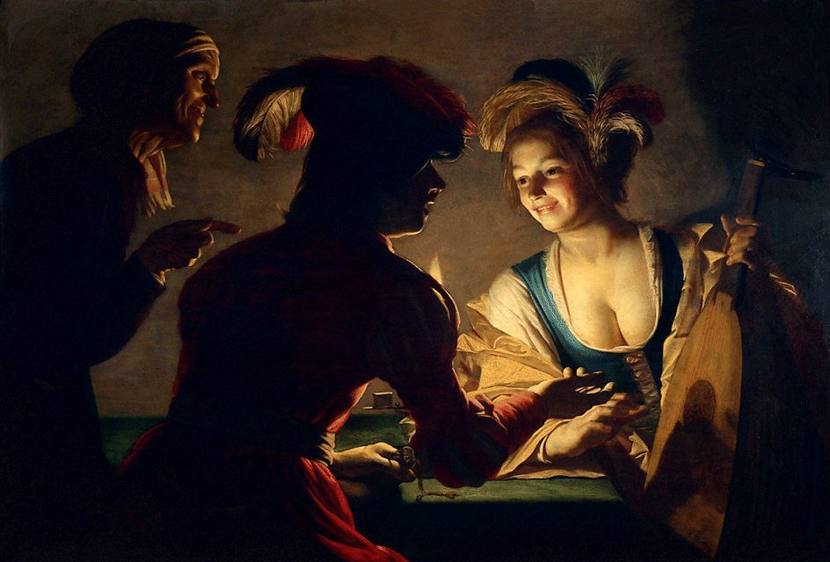
Art Elements
To analyse art you MUST be able to classify and describe the art elements
For some elements you can use normal adjectives to describe them, such as line- curving, jiggered, rough, light, thick, thin, bold, flowing etc.
But some elements like colour, space and tone have specific art language to classify them that will get you better marks
COLOUR: primary, secondary, tertiary, complementary, analogous, warm, cool, monochrome
SPACE: foreground, middle ground, background, negative space, positive space
TONE: high key, low key, chiaroscuro ------>
Chiaroscuro, in art, is the use of strong contrasts between light and dark, usually bold contrasts affecting a whole composition. It is also a technical term used by artists and art historians for the use of contrasts of light to achieve a sense of volume in modelling three-dimensional objects and figures.

Slide 6
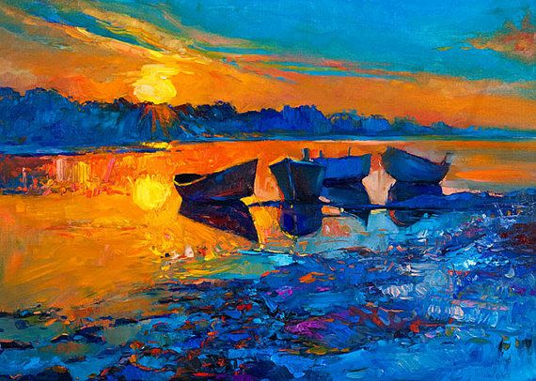
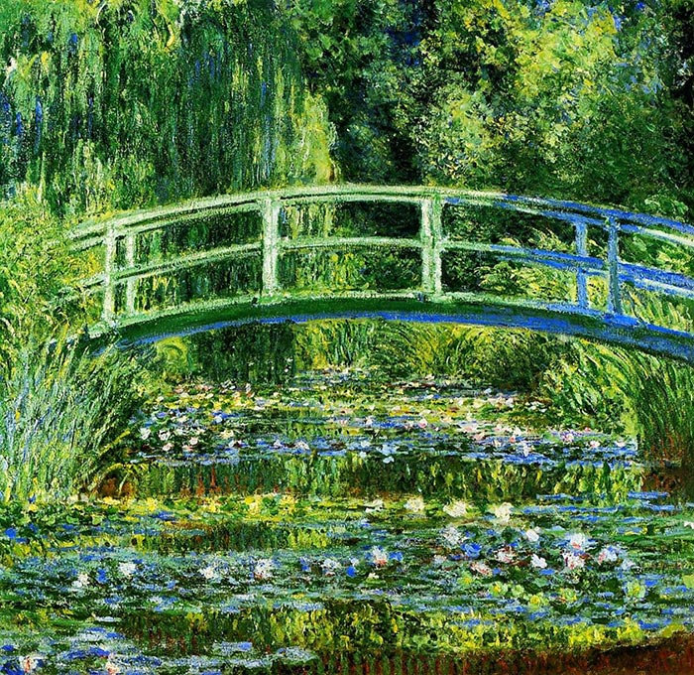
Art Principles
Art principles are created by how you arrange the art elements
Contrast is created by using opposites: complementary colours, dark and light tones, sharp and soft lines, curves and angles, large and small shapes
Contrast has the effect of making things stand out (use contrast instead of “pop”). When things stand out, they draw your eyes. When your eyes are drawn to something, we call it a focal point.
Harmony is created when an artwork looks peaceful and nice. To create harmony, artists use colours that look nice together, analogous colours, or all warm r all cool, or all of a similar tone

Slide 7
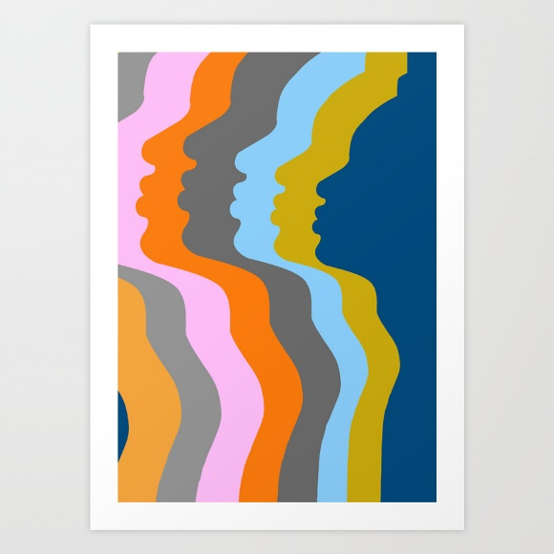
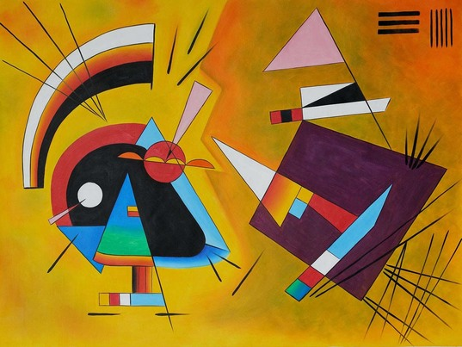
Art Principles
Unity is created when things work well together, the artwork looks like everything belongs
To create unity artists repeat certain aspects- such as repeated curves, repeated lines, repeated colours
Variety is when artists use different or contrasting art elements.
Variety keeps and artwork interesting and can draw your attention to a focal point.

Slide 8
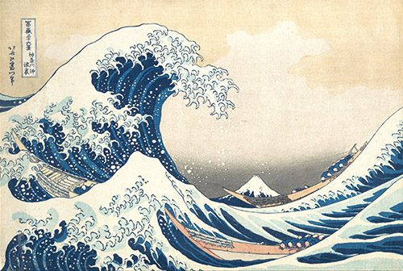
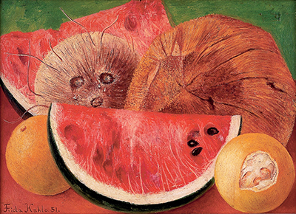
Art Principles
Movement is created when your eyes go on a journey around the artwork. Movement will give an artwork a sense of energy.
Movement is created by diagonal lines or curving lines that lead your eyes.
In contrast, stillness is created by using horizontal lines, vertical lines and by symmetry..

Slide 9
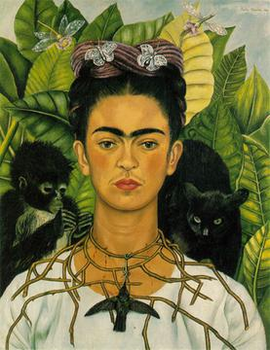
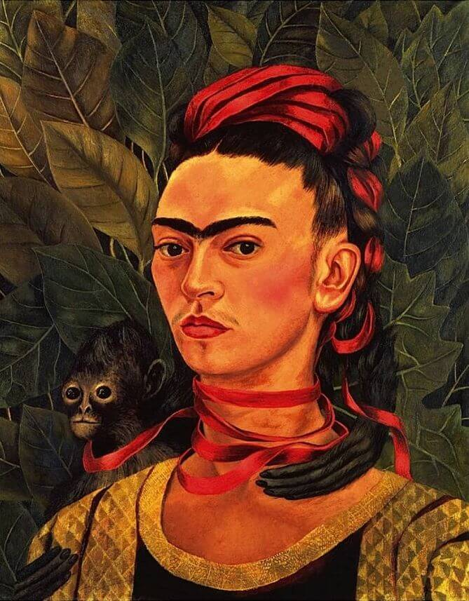
Art Principles
Self-Portrait with Thorn Necklace and Hummingbird, 1940- Frida Kahlo
Balance is when art artwork looks balanced. It is created by the composition of the objects and art elements in the image.
Symmetry is like a mirror image. Symmetry makes an artwork feel very static, stable, calm, oppressive.
Asymmetry is when the objects and art elements aren’t arranged as a mirror image but the artworks still looks balances. Think of an adult on the end of a sea saw and two little children on the other end.
You have to look at the artwork to see what’s creating the balance- is it the arrangements of shapes or colours or lines that balance it our? Is something small and bright balanced by something large but dark?
Asymmetry also creates movement, so it makes an artwork look dynamic, energetic, rhythmic, flowing and bouncy.
Which portrait by Frida artwork best shows- Symmetry vs Asymmetry?
Self Portrait with Monkey, 1940 by Frida Kahlo

Slide 10
How to write about aesthetic qualities
LOW/ SIMPLE EXPLANATION:
Identify what you’re talking about:
1a- Identify the aesthetic qualities and
1b- discuss the main art elements (and principles)
The bright, cheerful aesthetic quality is created by the use of primary and secondary colours and soft curving shapes.
The artwork has a gloomy, threatening quality created by the use of dark tertiary colours and dramatic changes in tone.
This can also be written in reverse, almost like a cause and effect:
The artist used warm colours to convey a positive and happy feeling.
CAUSE (link) EFFECT

Slide 11
More advanced discussion:
A more advanced sentence justifies your answer more fully by explaining the effect of the art elements in more details This usually involves describing the art principles.
Sentence structure may be: “cause makes the effect because explain”
The tumbling, curving lines of the clouds in the background make the painting feel energetic because they create the feeling of movement.
The painting feels calm because the straight horizontal lines of the clouds in the background create visual stability.
The complementary red and green of the buildings create a harsh contrast which gives a feeling of drama to the painting.

Slide 12
A typical question for discussion: Discuss how two art elements have been used to create aesthetic qualities in the artwork
The Broken Column
Frida Kahlo
1944
Identify what you’re talking about:
1a- Identify the aesthetic qualities and
1b- discuss the main art elements (and principles)
The raw, broken and painful aesthetic quality of this artwork is created by the bold lines and barren and earthy use of colour.
Explain the cause and effect (and \resulting art principles if possible!!!)
The exaggerated form and lines used to create the column running through her chest makes the artwork feel uneasy and painful.
The soft white sheet and hard white body brace contrast the earthen, desert background that feels dry and lifeless.
The thick, exposed lines, of the earth and Fridas body make the artwork feel brittle and isolating while creating a sense of unity between what she is feeling and what world is surrounding her.
The lines and form of the subject matter of the artwork creates symmetry which gives the artwork stillness and drama.

Slide 13
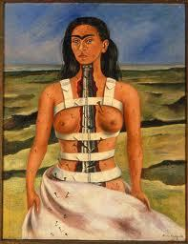
Discuss how two art elements have been used to create aesthetic qualities in the artwork – Paragraph Format
The Broken Column
Frida Kahlo
1944
In this painting, Kahlo has used the art elements of colour and line to create aesthetic qualities of stillness, lifelessness, pain and isolation. Kahlo used exaggerated form and lines used to create the column running through her chest, making the artwork feel uneasy and as though Kahlo is enduring physical pain. The colours used in the artwork are natural tones, whites, browns and blues. The soft white sheet and hard white body brace contrast the earthen, brown desert background that feels dry and lifeless. The thick, exposed lines, of the earth and Fridas body make the artwork feel brittle and isolating while creating a sense of unity between what she is feeling and what world is surrounding her. The soft lines to create Fridas form, as well as balance of colours between the earth and Fridas body- creates symmetry which gives the artwork a sense of stillness and drama.

Slide 14
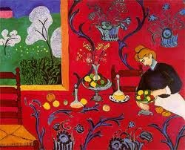
High scoring response from a past exam Choose one artwork from the detached insert and explain how art elements have been used to achieve aesthetic qualities….
In this painting Matisse has used the art elements of colour, shape and line to create aesthetic qualities of joyousness, wellbeing, and abundance. Matisse has used complementary tones of red and green to heighten the intensity of the colour, which gives a feeling of richness to the work. He has used rounded shapes in the pattern on the tablecloth and wall and in the shape of the trees and the woman’s hair. The curved lines of the trees are echoed in the outline of the woman’s skirt and hair and in the shapes of the fruit and decanter. In this painting colour, shape and line work together to achieve aesthetic qualities of peacefulness and harmony.

Slide 15
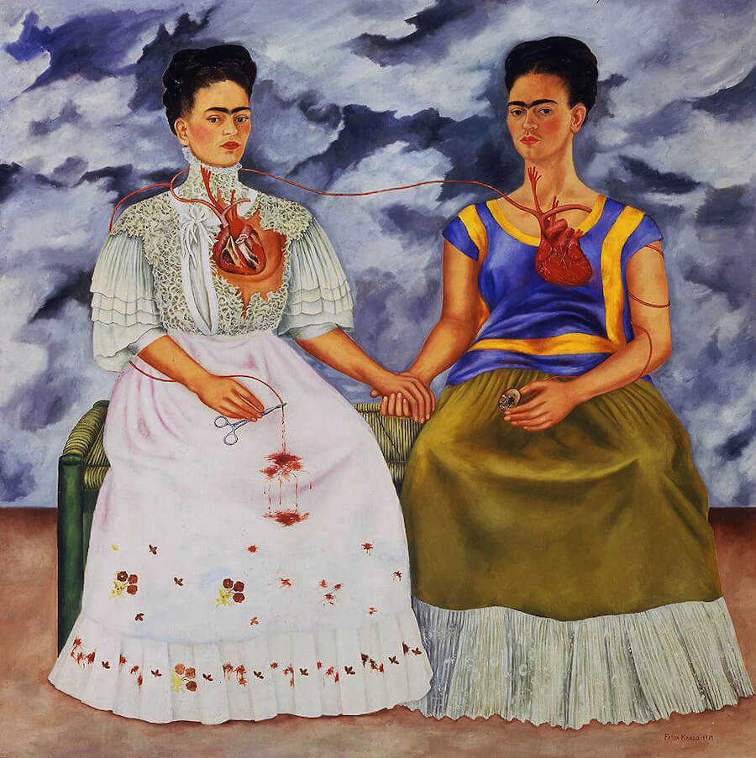
Lets try one together…
The Two Fridas
Oil Paint
Frida Kahlo
1939
Identify what you’re talking about:
1a- Identify the aesthetic qualities :
-pain, still, intense, emotional, miserable, lifeless, ominous
Unhappy, distressing, solidarity or power
1b- discuss the main art elements (and principles):
-Shapes
-Colours- contrast
-Tone
1a- Identify the aesthetic qualities and
1b- discuss the main art elements (and principles)

Slide 16
Paragraph format…
The Two Fridas
Oil Paint
Frida Kahlo
1939

